Slide 1




<ANGULAR />
Forms in Angular: Template-Driven vs. Reactive
Mastering User Input and Data Collection
Team Members : Rithika G Srujan P
Sangeetha S
Harshiya Saxena
Arshdeep S Virdi

Slide 2
<AGENDA />
Session Overview
01
Why Forms Matter
05
Validation
02
Template-Driven Forms
06
Use Cases
03
Reactive Forms
07
Summary
04
Comparison

Slide 3








<FORMS />
Why Forms Matter
Data Collection
The primary mechanism to collect user data and facilitate input for web applications.
CRUD & Auth
Essential for authentication and all CRUD operations that modify server state.
User-Logic Bridge
The critical bridge between user intent and complex backend business logic.

Slide 4
<FORMS / TEMPLATE>
Template-Driven Forms
01
Directives-based Heavy reliance on the HTML template using built-in directives.
03
Asynchronous Nature Angular handles the form control creation and updates asynchronously.
02
Two-Way Binding Uses [(ngModel)] to synchronize data between view and model.
04
Simplicity First Best suited for simple use cases and basic data collection forms.

Slide 5
<FORMS / REACTIVE>
Reactive Forms
01
Model-driven Approach
The form structure is defined programmatically in the TypeScript component class.
Core Building Blocks
FormControl: Tracks value and validation status of an individual field.
FormGroup: Manages a group of controls as a single unit.
FormArray: Handles a dynamic list of form controls.
02
Synchronous Data Flow
Provides immediate access to form data and status, making it highly testable and reliable.
Highly Scalable • Performance Oriented • Robust Validation • Developer Controlled

Slide 6
<FORMS / COMPARISON>
Comparison: Template vs. Reactive
Template-Driven
Reactive
• Easy to use
• More powerful & Better for testing
• Asynchronous
• Synchronous flow
• Minimal logic in Component
• Logic lives in Component

Slide 7
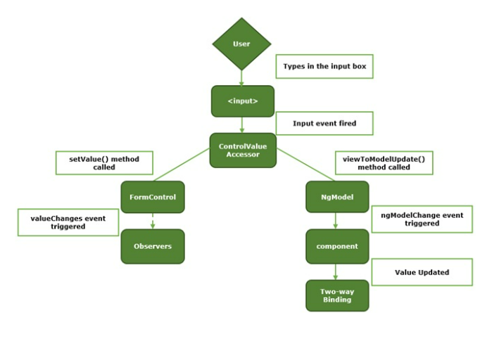
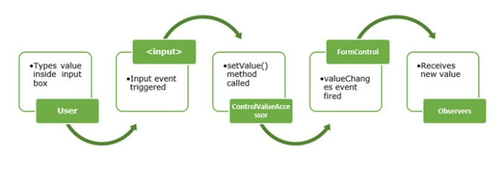
<FORMS / COMPARISON>
View-to-model
Template-Driven
Reactive

Slide 8
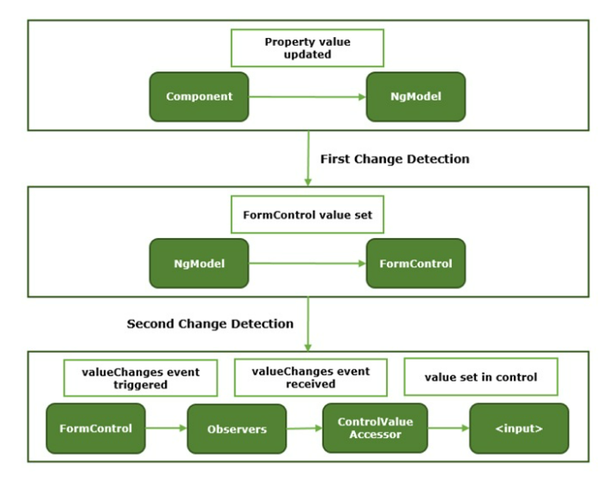
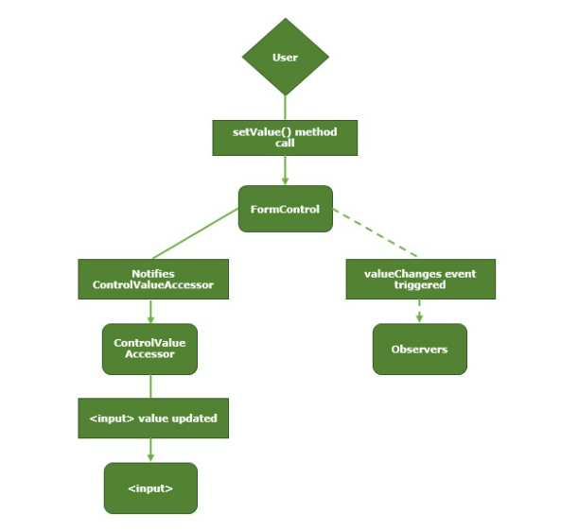
<FORMS / COMPARISON>
Model-to-View
Template-Driven
Reactive

Slide 9
<FORMS / VALIDATION>
Validation Demo
Built-in Validators
// TypeScript Validation Example
this.userForm = new FormGroup({
email: new FormControl('', [
Validators.required,
Validators.email
]),
password: new FormControl('', [
Validators.required
])
});
Validators.required Ensures the form control has a non-empty value.
Validators.email Checks if the value matches a proper email format.
Validators.minLength(n) Sets a minimum character threshold.
Reactive Validation • Sync Flow • Reusable Logic • Flexible

Slide 10
<FORMS / DEPLOYMENT>
Deployment Demo

Slide 11
<FORMS / DECISION GUIDE>
When to Use Which?
Template-Driven
Reactive
• Ideal for small, simple forms.
• Best for quick prototypes.
• Minimal component logic required.
• Handles complex business logic.
• Essential for dynamic field generation.
• Superior support for unit testing.
Simple Prototypes vs. Enterprise Scalability

Slide 12
<FORMS / USE CASES>
Real-World Scenarios
Simple Feedback Form
User Registration Hub
Template-Driven approach
• Static fields: Name, Email, Comment.
• Logic: "Send as-is" to an API.
• No complex cross-field validation or dynamic changes needed.
Reactive Forms approach
• Password Strength: Real-time regex validation.
• Email Check: Async validator for availability.
• Dynamic UI: Conditional fields based on user role.
Choose based on complexity: One-way data vs. High-fidelity interactions

Slide 13
<FORMS / SUMMARY>
Conclusion & Key Takeaways
The Right Tool
Final Verdict
• Template-Driven: Choose for speed, small-scale forms, and simplicity.
• Reactive: Choose for power, predictability, and complex business logic.
• Angular: Provides robust, first-class tools for both development patterns.
"Don't build a skyscraper with a hammer, and don't drive a nail with a crane."
Choose based on the complexity of your requirements.
Empowering Developers to Build Better Forms

Slide 14
<FORMS / FINISH>
Thank You & Q&A
Questions? Let's discuss building better forms together.

